Slide 1
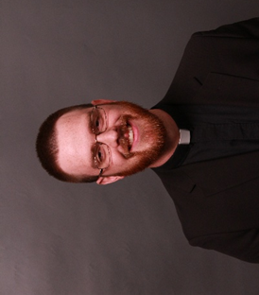
Please join in celebrating
“A Service of Installation”
for
Rev. Gideon Pullmann
As Pastor for Zion Evangelical Lutheran Church
Sunday, February 1st, 2026
4:00 PM
Zion Lutheran Church
301 W. First Street
Whitehall, MT
A reception will be held in the Parish Hall immediately following the Installation
Pastor Gideon Pullman is the fifth of six children, raised in Laurel, MT where his father continues to serve as the Pastor of St. John’s Lutheran Church. He attended high school in Concordia, MO at St. Paul Lutheran High School, a Lutheran boarding school, and then graduated from Concordia Ann Arbor from the pre-seminary program. Pastor Pullmann then attended Concordia Theological Seminary, in Fort Wayne, IN and graduated in 2018. He received his first call to serve as Pastor at Zion Lutheran in Tobias, NE, which later was joined with Immanuel Lutheran, Daykin, NE as a dual parish. In 2023, Pastor Pullmann was called to Faith Lutheran in Boulder, MT, which is now being joined with Zion Lutheran, Whitehall as dual parish.
Worship Services are at 8:30 every Sunday morning with Bible study afterwards.
All Are Welcome

